Slide 1
Update Your Toolbox with Growth Mindset and Positive Psychology
Christina Flanders, PsyD, NCSP
Tari Selig, MEd, CAGS

Slide 2
AGENDA
3 Things You Want
Gratitude
Gratitude/Happiness Activity
Happiness
Solution-Focused Counseling
Useful Resources

Slide 3
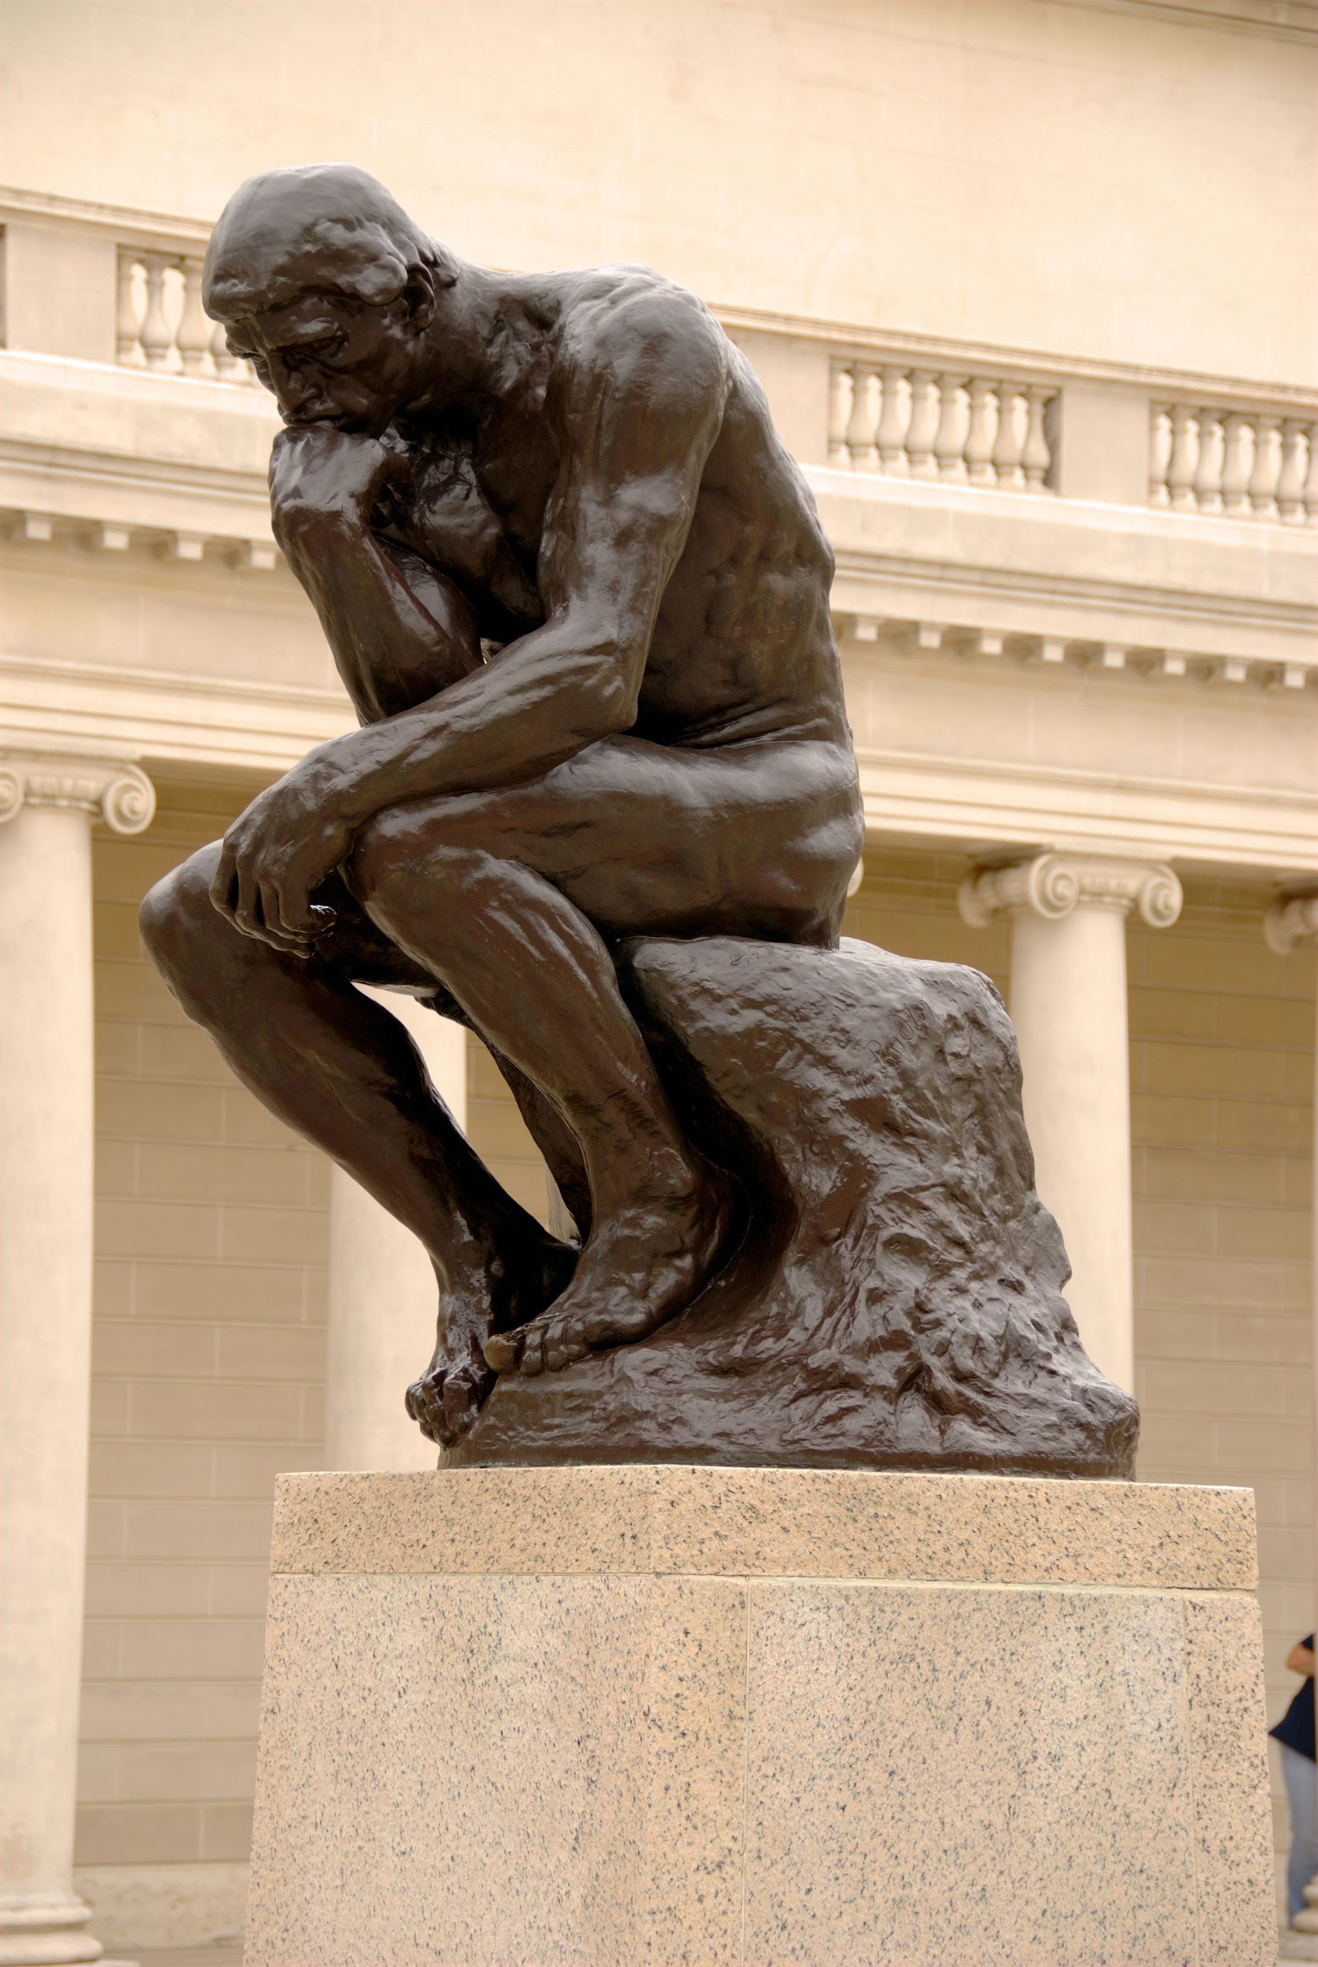
3 Things You Want
Take a minute to think about the students you work with and even your own children...
...Write down 3 things that you really, deeply, want for those children

Slide 4
Positive Psychology
What is it and how can I use it best?

Slide 5
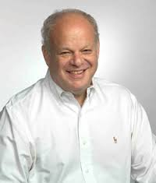
Positive Psychology - definition and origin
“The aim of Positive Psychology is to catalyze a change in psychology from a preoccupation only with repairing the worst things in life to also building the
best qualities in life.”
~Martin Seligman

Slide 6
Positive Psychology - Big 6 Concepts
Character
Strengths
Optimistic
Thinking
Serenity/
Mindfulness
Goal-Directed
Thinking
Happiness
Gratitude

Slide 7
Gratitude

Slide 8
Gratitude - What is it?
Gratitude is an emotion, an attitude, a stable trait and a character strength with 2 stages
First, you need to acknowledge something positive in your life
Then, understand that the source of the positive gift or experience is outside oneself
Thankfulness

Slide 9
Gratitude - Where’s the research?
Adolescents who developed gratitude over 4 years showed more prosocial behaviors and less antisocial behaviors compared to youth with low gratitude (Bono, Froh, Emmons & Card, 2013)
School satisfaction can be increased with gratitude intervention (Froh et al. 2008)
Gratitude can be taught to children as young as 8 with lasting results (Froh et al., in press)
People who express gratitude on a regular basis have better physical health, optimism, progress toward goals, well-being, and help others more (Emmons & Crumpler, 2000)
Grateful people tend to be more helpful, supportive, forgiving and empathic towards others, more agreeable, less narcissistic and less materialistic (McCullough et al., 2002)

Slide 10
Activities
to Promote Gratitude
Gratitude Journaling
Gratitude Visit
3 Good Things
Personal Gratitude List
Letting Go of a Grudge
For This I Am Grateful

Slide 11
Gratitude Journaling
A notebook or Google doc works fine
15 minutes of undisturbed time to write
Write between 3 and 5 things over the past week you’re grateful for (minor to major acts of kindness)
Try to focus on people and not things
Research says -- related to more optimism and life satisfaction, fewer physical complaints, less negative affect, more school satisfaction posttest

Slide 12
Gratitude Visit
Express gratitude to another through writing and delivering a letter of thanks
Read the letter to them
Research says -- Compared to youths who did not write a letter to someone expressing their gratitude, the youths in the gratitude condition who were low in positive affect reported more gratitude and positive affect at posttreatment and more positive affect at the 2-month follow-up

Slide 13
3 Good Things
In a notebook/journal, record three things that went well each day and beliefs about what caused the positive event
Do it for a week and see the results
Research says -- Positive results include more happiness and fewer symptoms of depression

Slide 14
Personal Gratitude
List
Personal Gratitude List
________ was kind to me today.
Today the thing I enjoyed most was ____.
I helped _______ today.
Today I learned ________.
In mistakes I made today, I learned that _________.
This person made me feel important today. __________
Something I couldn’t do last week that I can do today is __________.
One simple thing that made my day good was ________.
__________ made me smile today.
Today my favorite taste, touch, smell, sight or sound was _________.
A student completes sentence stems that are designed to help them reflect on people and experiences for which they were grateful
Example: “Someone who helped me get through a difficult time is __________”

Slide 15
Letting Go of a Grudge
Think of a person you’re holding a grudge against
Recall and write down as many things as you can about that person which you are grateful for

Slide 16
Letting Go of a Grudge
Chooses me to read with
Offers to help me
Plays with me at recess
Shares toys with me
Is nice to me at school
Calls me when I’m sick at home

Slide 17
Letting Go of a Grudge
Write down the grudge you’re holding on to on the same page

Slide 18
Letting Go of a Grudge
Chooses me to read with
Offers to help me
Plays with me at recess
Didn’t get invited to friend’s birthday party
Shares toys with me
Is nice to me at school
Calls me when I’m sick at home

Slide 19
Letting Go of a Grudge
Look at what you’ve written
Do you feel any differently?
Do you feel ready/willing to forgive?
Are you in a better position to continue a relationship/friendship with that person?

Slide 20
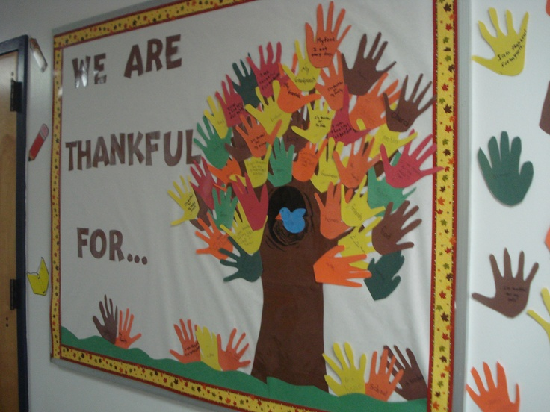
For This I Am Grateful
Bulletin board or poster
Students draw pictures (or other media outlets) of things for which they are grateful
Can be a collage of words, photos, quotes, etc. that reflect things they are grateful for

Slide 21
Gratitude
in Action
The intersection of gratitude and happiness

Slide 22
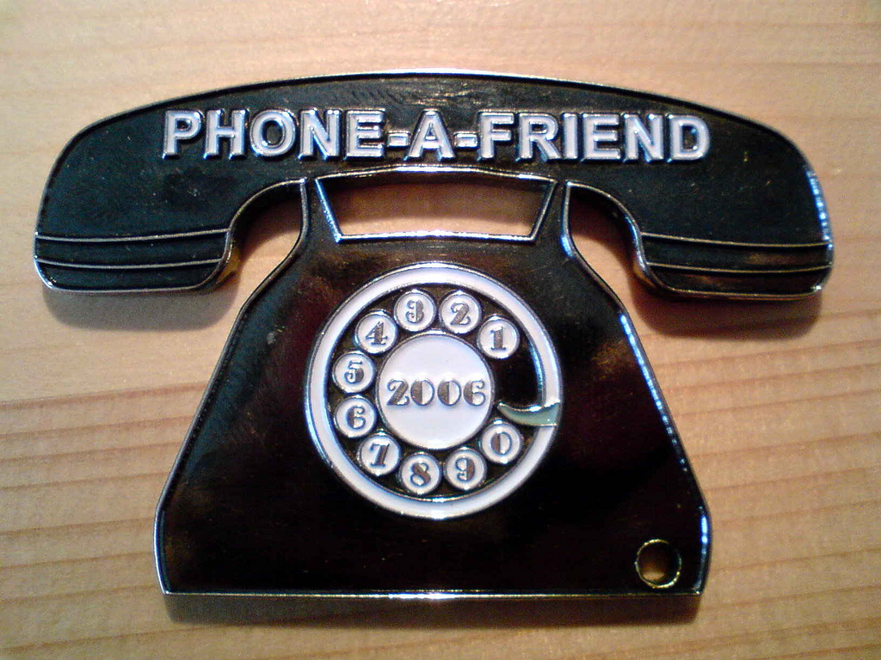
Your Turn

Slide 23
Gratitude Resources
The Greater Good Science Center (Berkeley, CA) - conducts and consolidates research on gratitude (among other things) and creates tools for practitioners
Thnx4.org - an online, shareable gratitude journal, sends you automatic reminders and asks questions before each session to assess your mindset before the session
KindSpring.org - holds a 21-day gratitude challenge (among other challenges)
edX.org - free 8-week course “The Science of Happiness” offers an in-depth look at the gratitude journal

Slide 24
Happiness

Slide 25
Happiness - What is it?
Subjective well-being
Components: life satisfaction, positive and negative affect
Not all negative emotions are bad: anxiety, fear, guilt
Research says - Happiness leads to better physical health and recovery, longer life, stronger immune systems, more productivity and creativity in work, better social functioning and academic achievement (Suldo, Huebner, Savage & Thalji, 2011).

Slide 26
Activities
to Promote Happiness
Me at My Best
Acts of Kindness

Slide 27
Me at My Best
Reflect on times you’ve excelled at something, what were your inner qualities that helped you succeed in those moments?
Should be entirely based on strengths
Research says - Experiencing positive emotions creates an increase in cognitive capacity and behavioral flexibility that in turn has positive impacts on social relationships and well-being

Slide 28
Acts of Kindness
Do kind things for others
Pick a goal of 1 or 2 a day and discuss them during class or small groups; how did that person respond? How do you feel?
Pay it Forward
Example: school activity involving acts of kindness and paying it forward

Slide 29
Happiness - Resources
World Database on Happiness - all things related to happiness research http://www.worlddatabaseofhappiness.eur.nl/
Livehappy.com - good resource for current articles and podcasts related to positive psychology in general and specific items related to Happiness
Atmybest.com - for profit (some free options) resource to track Happiness using Strength Cards and engaging visual App and online tool to use with students
Positivepsychologyprogram.com - great resource (some free and some for pay) for finding specific activities to do with students and to explain concepts more in-depth
Acts.kindness.org - an abundance of suggested activities to do with children and youth

Slide 30
Creating Positive Institutions
Create a more positive institution:
Emphasize the Importance of Praise
Use Prompts
Provide In-Class Performance Feedback
Teach Self-Recruitment of Praise

Slide 31
Self-Recruiting Praise
Discuss the rationale for recruiting teacher attention with the student
Instruct students on when, how and how often to ask for help
Model the recruiting strategy using a think-aloud procedure
Okay, i’ve finished about half of my math problems and want to know how I’m doing
Now I will look for the teacher
She’s not busy, I’ll raise my hand now
The teacher and students then role-play five different recruiting episodes
The teacher asks the students to state the steps.

Slide 32
Positive Psychology Summary
It (usually) doesn’t cost anything and is easy to implement
Improves self-worth and satisfaction with life and school (research-supported)
Dovetails quite nicely with academic tasks
Makes you feel good
Adopt an ‘Attitude of Gratitude’

Slide 33
Solution-Focused Counseling
in Schools

Slide 34
Solution-Focused Counseling in Schools
Common Factors of Change
Client Factors- 40% of Change
Everything that the client brings to counseling-strengths, interests, values, social supports, resilience, and other resources
Relationship Factors- 30% of Change
Experience of respect, collaboration, acceptance, and validation from counselor
Hope Factors- 15% of Change
Client’s positive expectancy and anticipation of change
Model/Technique factors- 15% of Change
Counselor’s theoretical model and intervention techniques

Slide 35
Key Assumptions of Solution-Focused Counseling in Schools
If it works, do more of it. If it doesn’t, do something different
Every client is unique, resourceful and capable of changing
Cooperative relationships enhance solutions
Client feedback improves outcome
No problem is constant
Big problems do not always require big solutions

Slide 36
Tasks of Solution-Focused Counseling
Establish cooperative, change-focused relationships
Clarify the problem and related details
Develop clear and meaningful goals
Build on expectations and other resources
Change the doing or viewing of the problem
Evaluate and empower process

Slide 37
Tools for Solution-Focused
Establish Cooperative, Change Focused Relationships
“How is this a problem for you?”
“I wonder what would happen if you tried something really different next time?”
“No wonder you’re so upset about this?”
“How did you manage to stay in there instead of giving up?”

Slide 38
Tools for Solution-Focused
Clarify the Problem and Related Details
“What does ____ look like?”
“What have you already tried and how did it work?”
“What needs to happen to make things better at school?”

Slide 39
Tools for Solution-Focused
Develop Clear and Meaningful Goals
Magical Question
“Let’s pretend it is one month from now and school is much better, and that you made some changes to make that happen. Tell me the first couple small steps or changes you made to turn things around at school”

Slide 40
Tools for Solution-Focused
Build on Exceptions and Other Resources
“Tell me about a time when the problem did not happen or was less intense”
“How have you kept things from getting worse?”
“What do you think would help turn things around at school?”

Slide 41
Tools for Solution-Focused
Change the Doing or Viewing of the Problem
“This doesn’t seem to be working for you, but I don’t have any better ideas. I’m going to suggest the Do Something Different Experiment, where you try something really different and observe the results”

Slide 42
Tools for Solution-Focused
Evaluate and Empower Progress
“How did you manage to make these improvements?”
“How do your teachers treat you differently now that you’ve made these changes?”
“What advice would you give to another 4th grader who has this problem?”

Slide 43
Positive psychology activities and solution-focused counseling are evidence-based interventions easily transferrable to schools

Slide 44
References
Froh, J. J., & Bono, G. (2011, January/February). Gratitude in youth: A review of gratitude intervention and some ideas for applications. Communique. Bethesda, MD: NASP.
Furlong, M. J., Gilman, R., & Huebner, E. S. (eds.). (2014). Handbook of positive psychology in schools. (2nd ed.). Routledge: New York, NY.
Huebner, S. (2012, October). Ten ways to infuse positive psychology in the schools. Communique. Bethesda, MD: NASP.

